Slide 2
Deep Learning for Lung Cancer Detection
Dr. Miguel Fierro
@miguelgfierro

Slide 3
Session Goals
Transfer Learning as a Baseline algorithm
Demo of Transfer Learning (and more)
Deep Learning in a SQL database
Notes:
This slide is required. Do NOT delete. This should be the first slide after your Title Slide.
This slide should describe what your goals are for this session. This information lets your audience know what you are trying to accomplish with your talk or tutorial—ie, what value will attendees get by investing 25 minutes or 2 hours of their time listening to you.
You should not spend more than 1 minute presenting this slide.
General examples of session goals could be (you will have to create your own specific goals):
Introduce a new technique or approach to solve a customer problem
Compare two approaches and explain why one is superior
Describe a project and the learnings that audience members can apply from it
Teach audience members how to use a specific technology

Slide 4
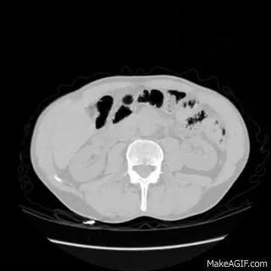


Lung Cancer Competition
Determine whether a patient has cancer or not
competition
$1 million in prizes !
CT scan: horizontal section of lung
AI Immersion - Dr. Miguel Fierro - @miguelgfierro
Notes:
This slide is required. Do NOT delete. This should be the first slide after your Title Slide.
This slide should describe what your goals are for this session. This information lets your audience know what you are trying to accomplish with your talk or tutorial—ie, what value will attendees get by investing 25 minutes or 2 hours of their time listening to you.
You should not spend more than 1 minute presenting this slide.
General examples of session goals could be (you will have to create your own specific goals):
Introduce a new technique or approach to solve a customer problem
Compare two approaches and explain why one is superior
Describe a project and the learnings that audience members can apply from it
Teach audience members how to use a specific technology

Slide 5
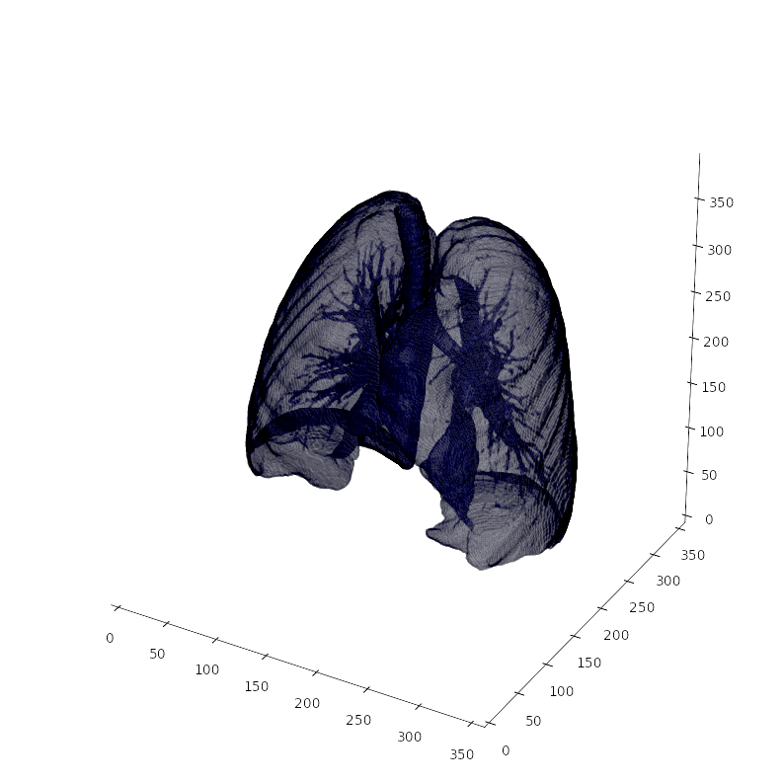
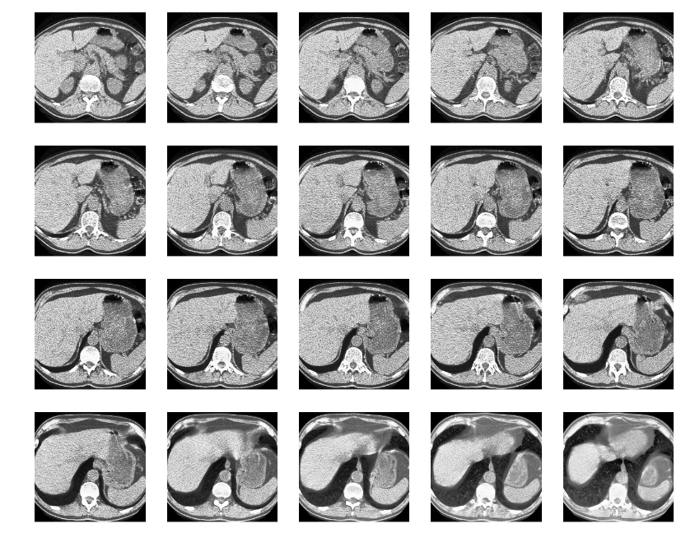
Data
1595 patients with a diagnostic
200-500 scans per patient
Images of 512x512
AI Immersion - Dr. Miguel Fierro - @miguelgfierro

Slide 6
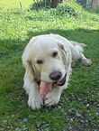
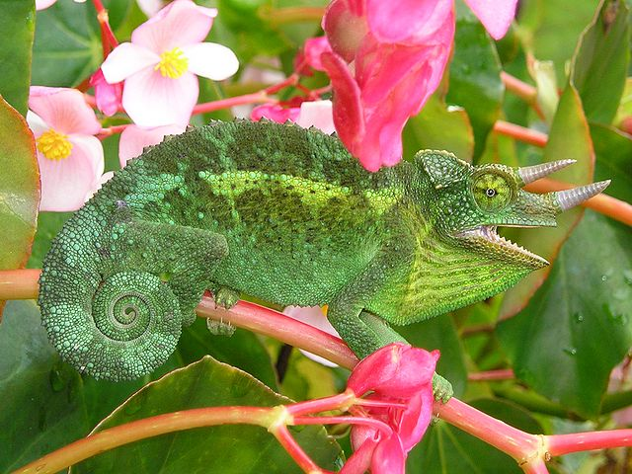
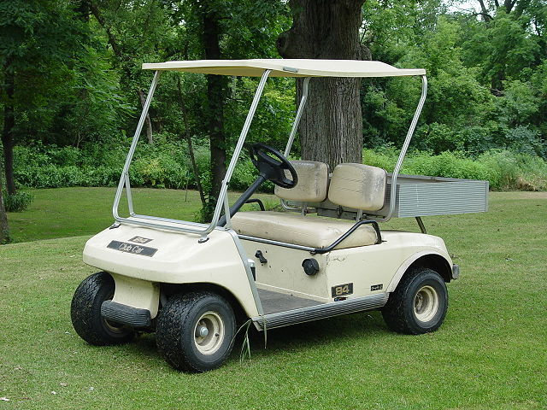
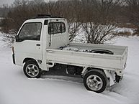
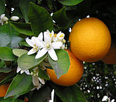
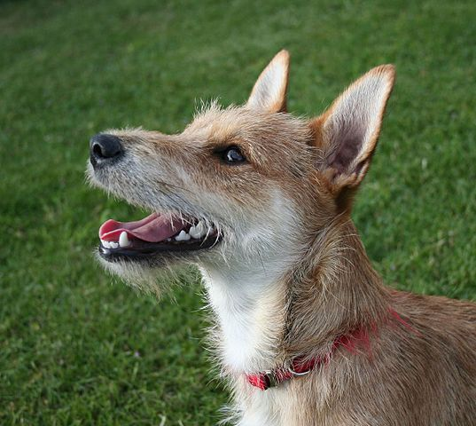
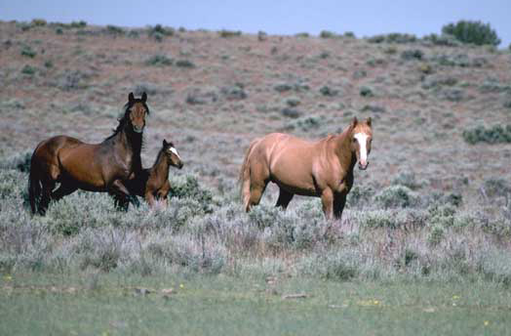
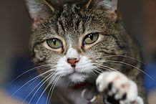
Transfer Learning
ImageNet dataset
Lung cancer dataset
weight transference
AI Immersion - Dr. Miguel Fierro - @miguelgfierro

Slide 7
Baseline algorithm
CNTK
k batch
of images
= 1 patient
penultimate
layer
224
features
224
3
ResNet N-1 layers
AI Immersion - Dr. Miguel Fierro - @miguelgfierro

Slide 8

Baseline algorithm
CNTK
LightGBM
k batch
of images
= 1 patient
penultimate
layer
224
features
no
cancer
224
3
Boosted tree
ResNet N-1 layers
AI Immersion - Dr. Miguel Fierro - @miguelgfierro

Slide 9

Demo
AI Immersion - Dr. Miguel Fierro - @miguelgfierro

Slide 10
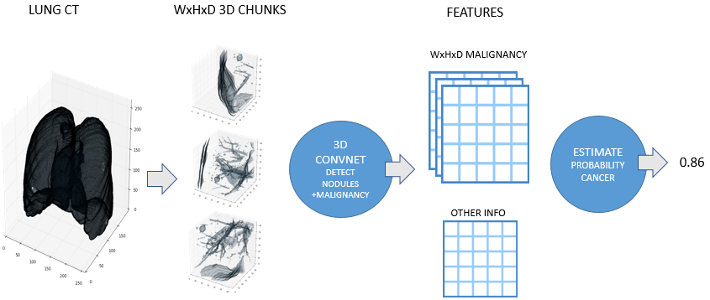
2th Place in the Lung Cancer Competition
Julian de Wit & Daniel Hammack
https://github.com/juliandewit/kaggle_ndsb2017
AI Immersion - Dr. Miguel Fierro - @miguelgfierro

Slide 11



Traditional python vs SQL python
data
Don’t move huge amounts of data
Don’t move critical data
AI Immersion - Dr. Miguel Fierro - @miguelgfierro

Slide 12

Traditional python vs SQL python
data
data
Don’t move huge amounts of data
Don’t move critical data
AI Immersion - Dr. Miguel Fierro - @miguelgfierro

Slide 13
SQL python example
CREATE PROCEDURE [dbo].[PredictLungCancer]
@PatientIndex INT,
@PredictionResult FLOAT OUTPUT
AS
BEGIN
DECLARE @predictScript NVARCHAR(MAX);
SET @predictScript = N’
from python_package.lung_cancer_lib import score_patient_with_deep_learning_model
PredictionResult = score_patient_with_deep_learning_model(PatientIndex)
‘
EXECUTE sp_execute_external_script
@language = N'python',
@script = @predictScript,
@params = N'@PatientIndex INT, @PredictionResult FLOAT OUTPUT',
@PatientIndex = @PatientIndex,
@PredictionResult = @PredictionResult OUTPUT;
SELECT @PredictionResult
AI Immersion - Dr. Miguel Fierro - @miguelgfierro

Slide 14
Thank you
Dr. Miguel Fierro
@miguelgfierro

